Slide 1
Section 6.5
Properties of Logarithms
Copyright © 2012 Pearson Education, Inc. Publishing as Prentice Hall.

Slide 2
Copyright © 2012 Pearson Education, Inc. Publishing as Prentice Hall.

Slide 3

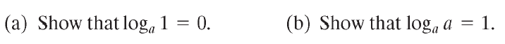
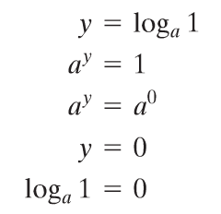
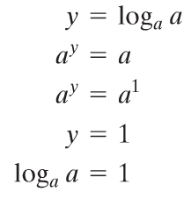

Copyright © 2012 Pearson Education, Inc. Publishing as Prentice Hall.

Slide 4

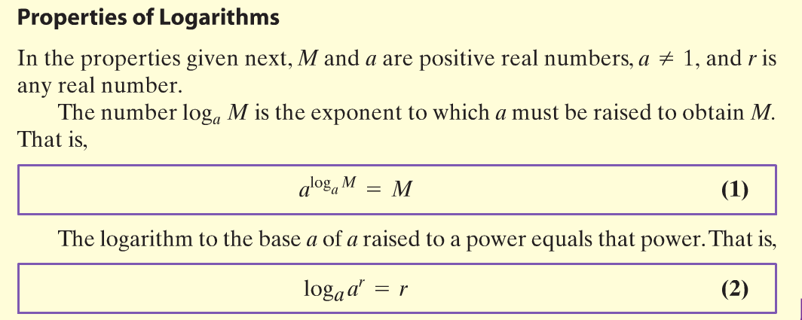
Copyright © 2012 Pearson Education, Inc. Publishing as Prentice Hall.

Slide 5
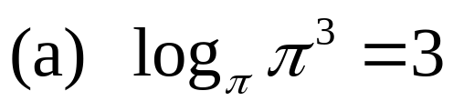
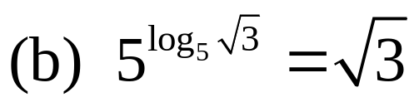
Property (2)
Property (1)
Property (2)
Copyright © 2012 Pearson Education, Inc. Publishing as Prentice Hall.

Slide 6
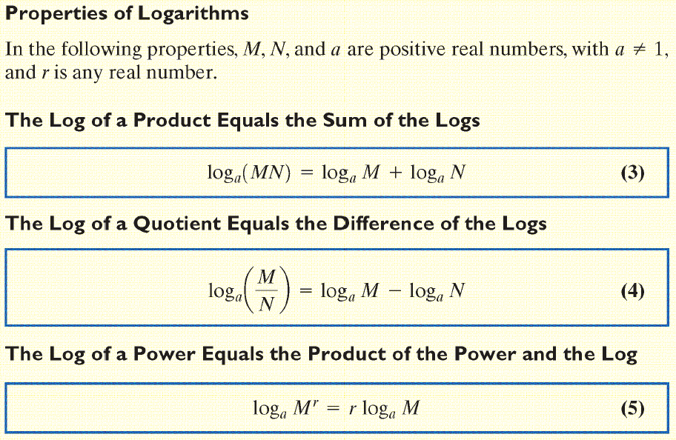
Copyright © 2012 Pearson Education, Inc. Publishing as Prentice Hall.

Slide 7

Copyright © 2012 Pearson Education, Inc. Publishing as Prentice Hall.

Slide 8
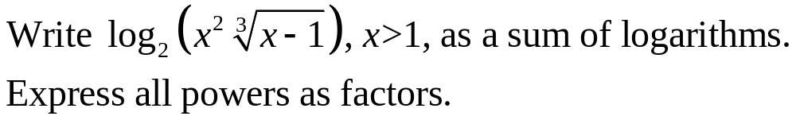
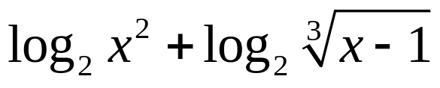

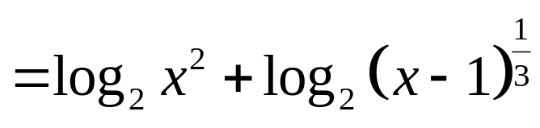
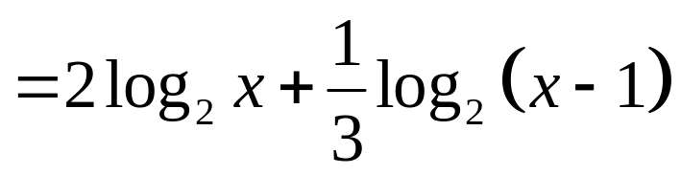

Copyright © 2012 Pearson Education, Inc. Publishing as Prentice Hall.

Slide 9
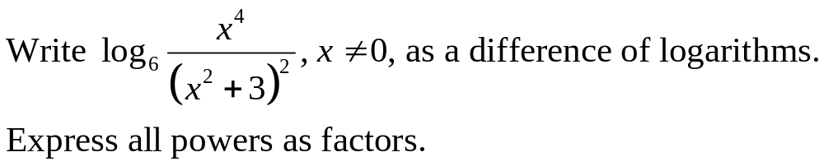
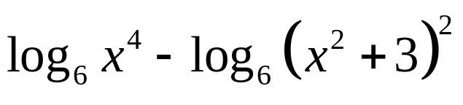

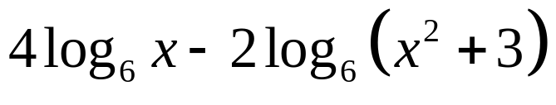
Copyright © 2012 Pearson Education, Inc. Publishing as Prentice Hall.

Slide 10

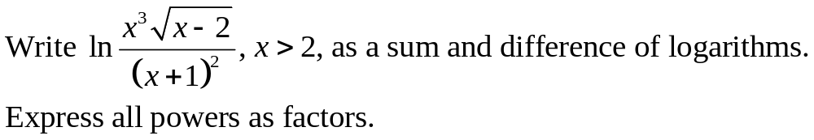
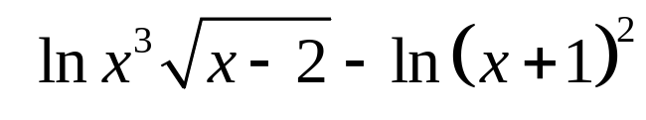
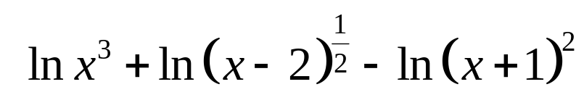
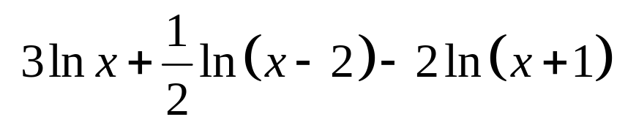
Copyright © 2012 Pearson Education, Inc. Publishing as Prentice Hall.

Slide 11
Copyright © 2012 Pearson Education, Inc. Publishing as Prentice Hall.

Slide 12
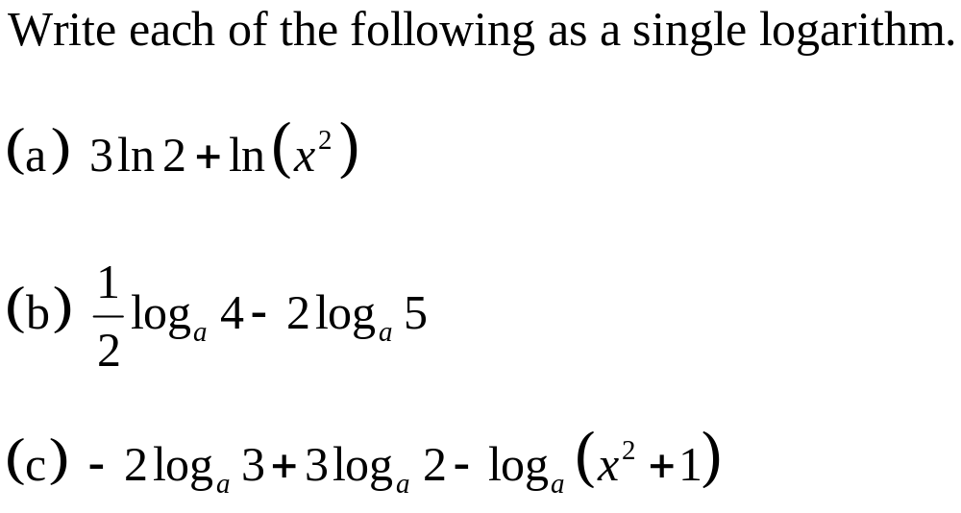
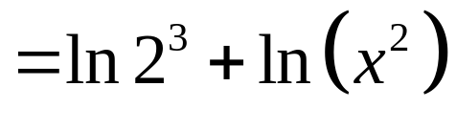
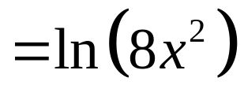
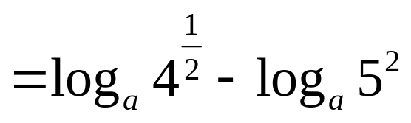
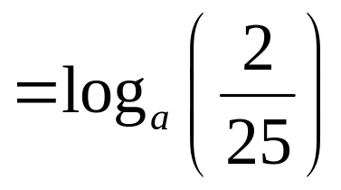
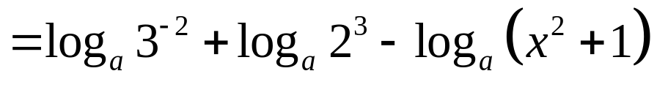
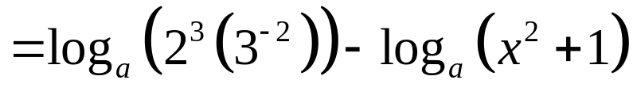
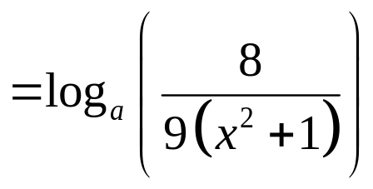
Property (5)
Property (3)
Property (5)
Property (4)
Property (5)
Property (3)
Property (4)
Copyright © 2012 Pearson Education, Inc. Publishing as Prentice Hall.

Slide 13
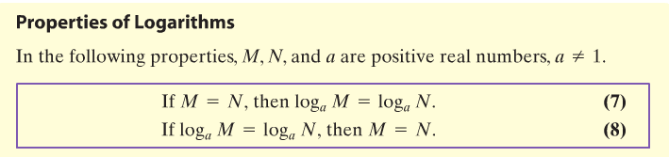
Copyright © 2012 Pearson Education, Inc. Publishing as Prentice Hall.

Slide 14
Copyright © 2012 Pearson Education, Inc. Publishing as Prentice Hall.

Slide 15
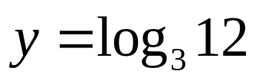




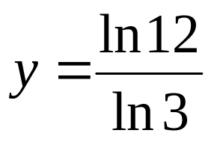
Exponential form
Property (7)
Property (5)
Approximate value
Exact value
Copyright © 2012 Pearson Education, Inc. Publishing as Prentice Hall.

Slide 16
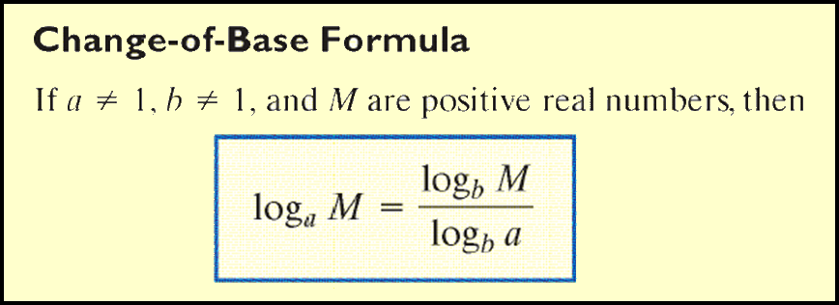
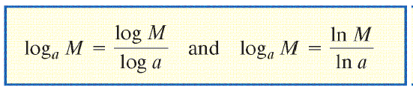
Copyright © 2012 Pearson Education, Inc. Publishing as Prentice Hall.

Slide 17

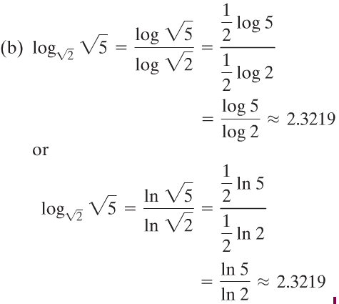
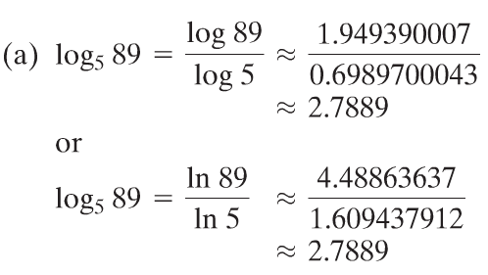
Copyright © 2012 Pearson Education, Inc. Publishing as Prentice Hall.

Slide 18
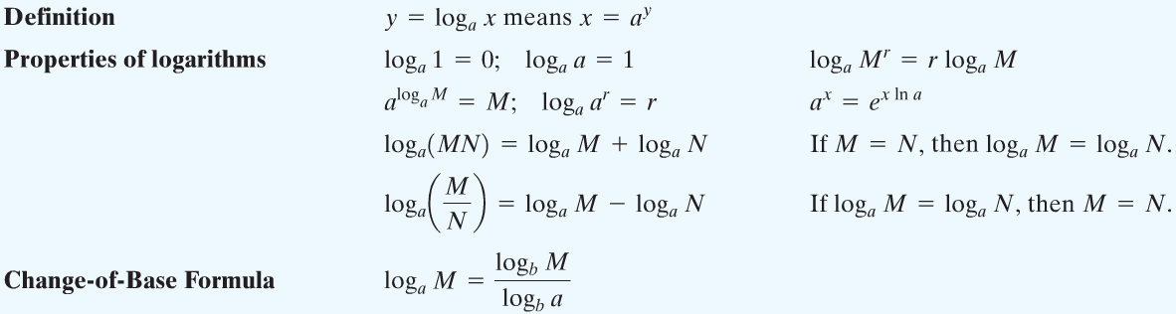
Copyright © 2012 Pearson Education, Inc. Publishing as Prentice Hall.

